Slide 1
Digital Image Transforms

Slide 2
Image Processing Operations
  Spatial Domain
    Directly operates on the pixel intensities
    Can be visualised easily
  Frequency Domain
    Deals with the frequency components of the images

Slide 3
  Real Time image Processing Applications
    Biometric System – Fingerprint based attendance
    Airport baggaging screening system
    Radar Image monitoring
  Important Requirement
    Speed
    Simple operations
  Frequency domain serves both
  A change in the problem representation – solves the problem faster

Slide 4
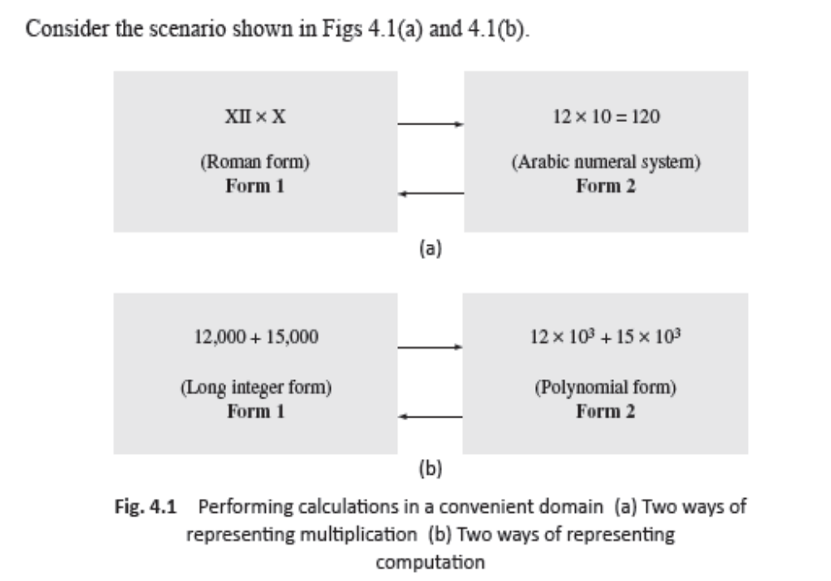
NEED FOR IMAGE TRANSFORMS

Slide 5
Spatial domain and
Frequency domain
These are different representations of the same information
Calculations in the frequency domain are simpler
1
SPATIAL
DOMAIN
FREQUENCY
DOMAIN
2

Slide 6
Example
Transforms | Inverse Transforms
Fourier – DFT, 2D DFT | Inverse DFT, Inverse 2D DFT
DCT –Discrete Cosine Transforms | IDCT
DWT – Discrete Wavelet Transforms | IDWT

Slide 7
Types of image transforms
Essentially there are two categories of transforms available
1. Orthogonal
Fourier, DCT
2. Non-sinusoidal.
Haar, Hadamard, Walsh

Slide 8
Practical Applications of Image Transforms
Useful in understanding Sampling
Energy Preservation – Signal energy is preserved
Energy Compaction
  large fraction of the average energy of the image is packed into a few components, in transform domain
  Uneven distribution of energy
  Many co-eff. have negligible energy; useful in compression

Slide 9
Helps to design faster algorithms
Helps to assess image quality
  Frequency denotes repetitive noise patterns. Presence or absence of high/low areas
  Spectrum images of a clean and a noisy image
Orthogonal transforms
  Co-eff. are all real nos.
Hermitian transforms
  Co-eff. are all complex nos.

Slide 10
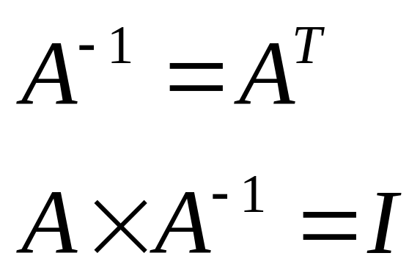
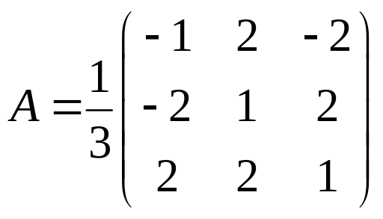
Orthogonal Matrix

Slide 11

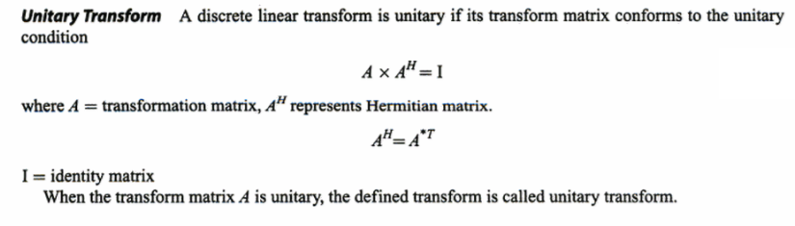
Unitary Transform

Slide 12
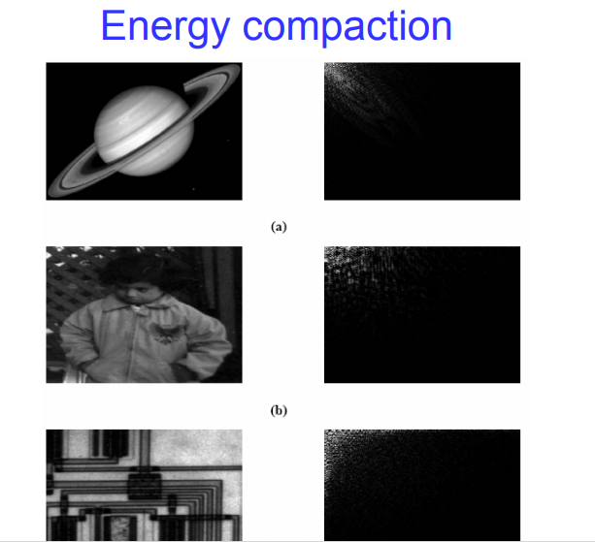

Slide 13
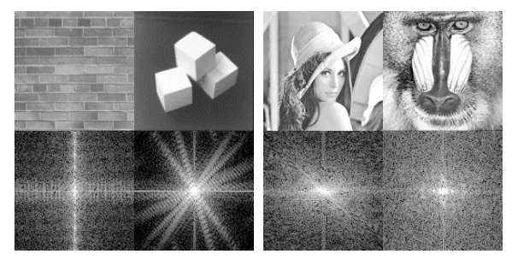
Fourier Transform of Natural Images

Slide 14

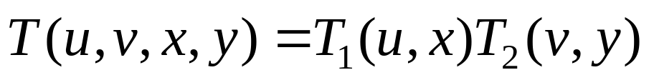

Transforms
T(u,v,x,y) – Forward transformation
I(x,y,u,v) – Inverse tranformation
Main task – Find a suitable kernel
The forward kernel is said to be separable if
It is said to be symmetric if is functionally equal to such that

Slide 15
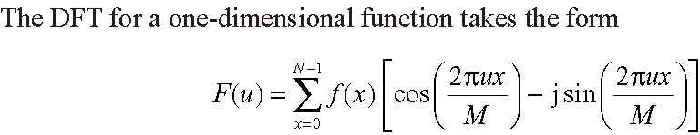
DFT

Slide 16
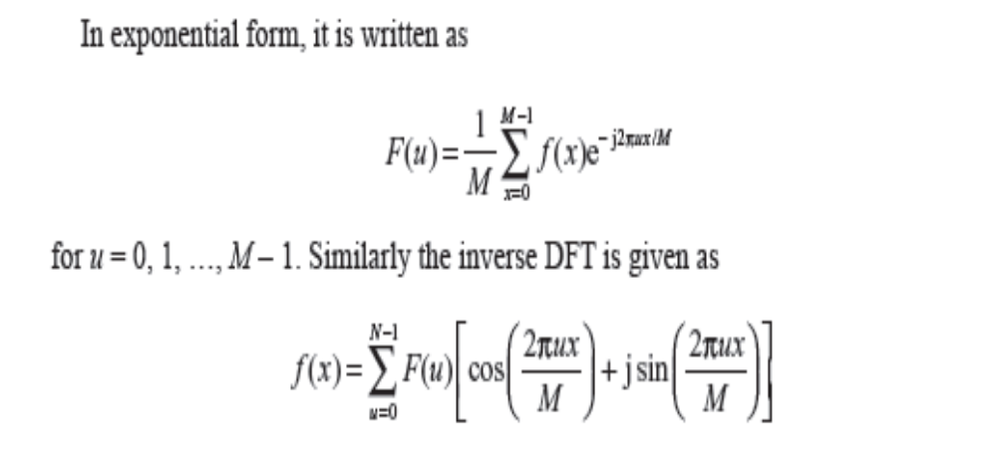

Slide 17
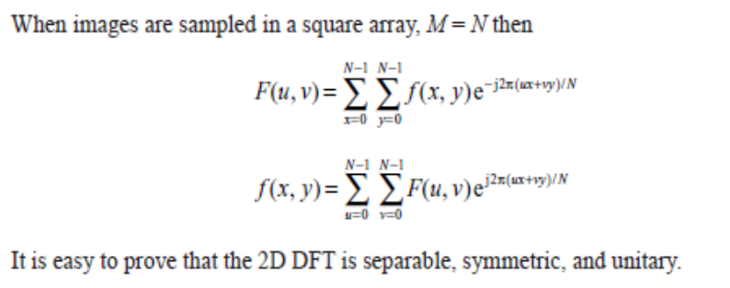

Slide 18
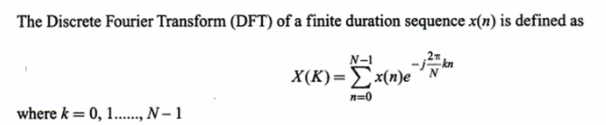
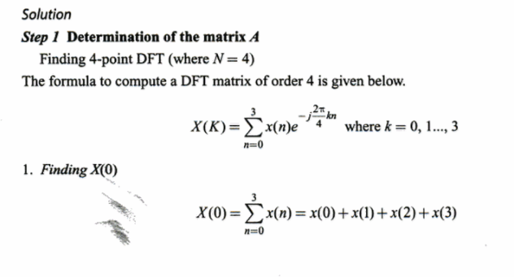
Check whether 4 point DFT(x) is Unitary

Slide 19
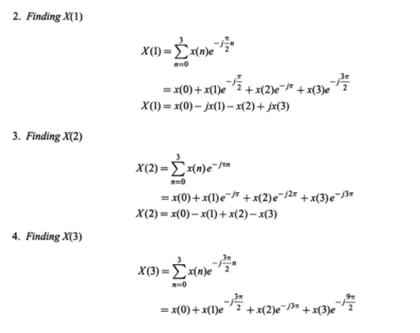

Slide 20
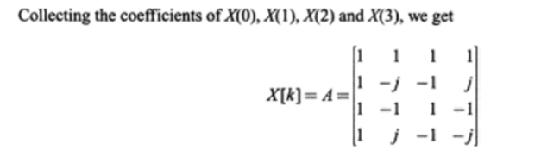

Slide 21
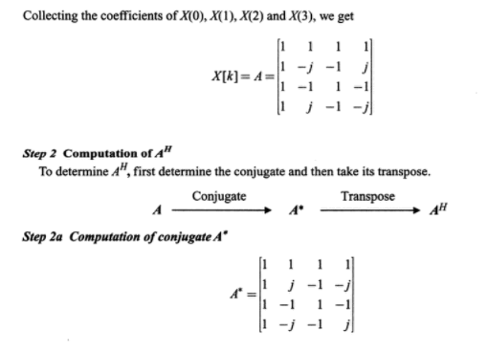

Slide 22
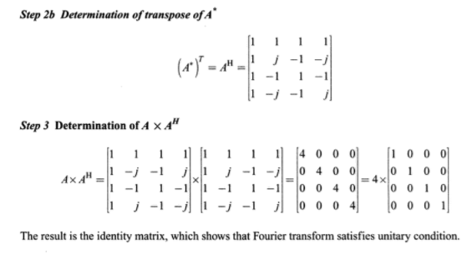

Slide 23
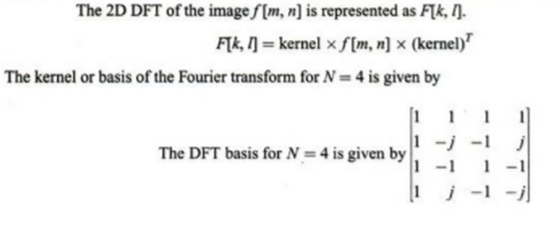


Slide 24
Compute 2D DFT of the 4x4 gray scale image
f(m,n)=
1 | 1 | 1 | 1
1 | 1 | 1 | 1
1 | 1 | 1 | 1
1 | 1 | 1 | 1

Slide 25
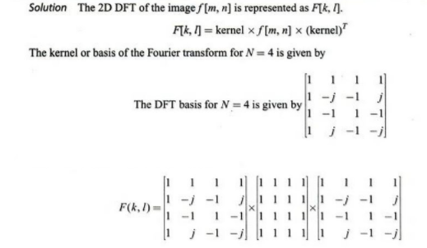

Slide 26
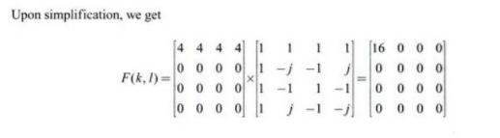
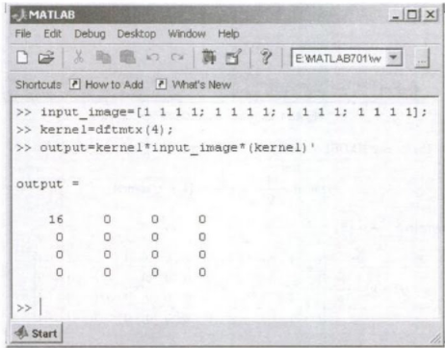
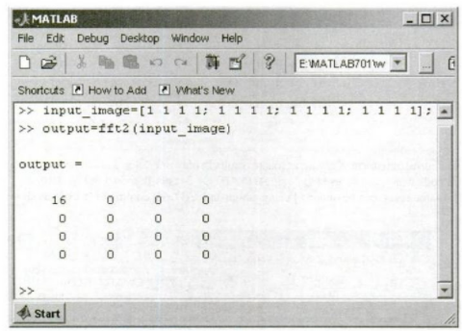

Slide 27
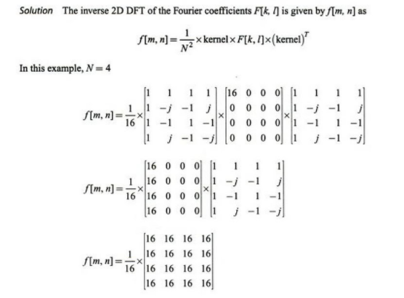
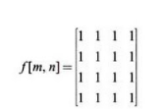

Slide 28
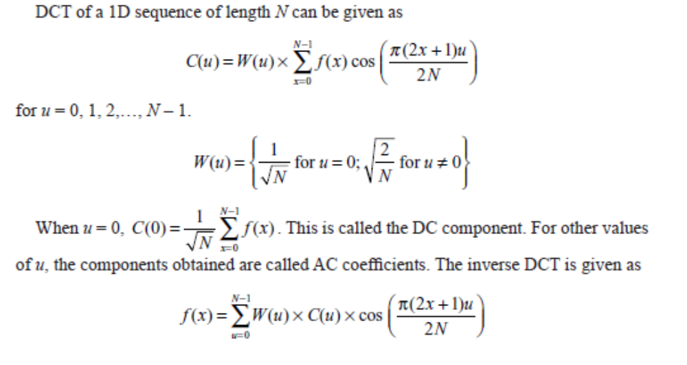
Discrete cosine Transform

Slide 29
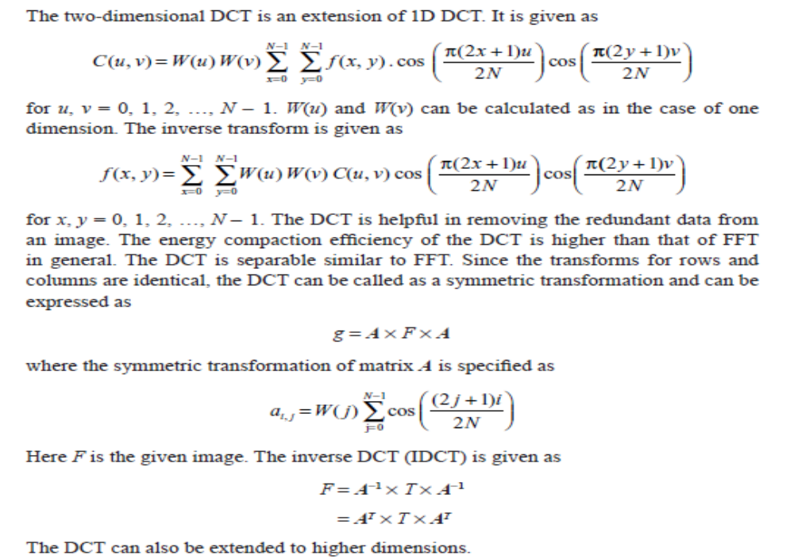

Slide 30
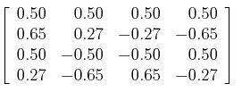
DCT matrix of order 4

Slide 31


Slide 32
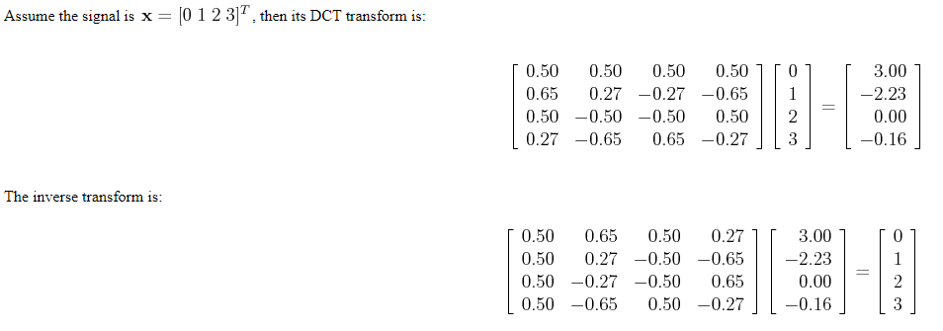

Slide 33
Apply 2D DCT
1 2 3 1
1 4 5 1
6 1 1 1
1 1 1 1

Slide 34
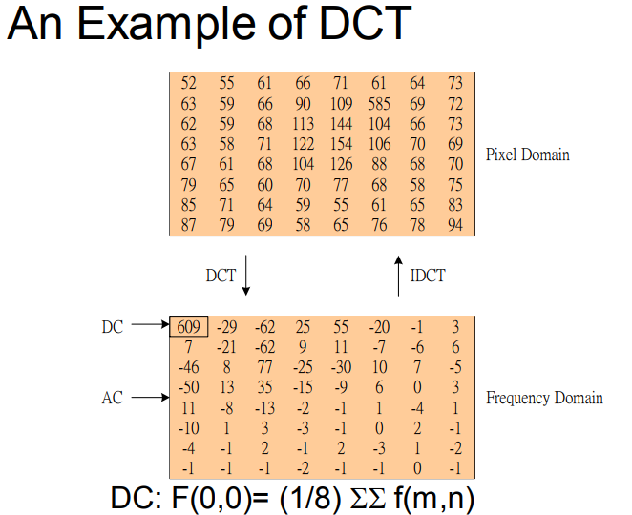

Slide 35
2D Hadamard Transform

Slide 36
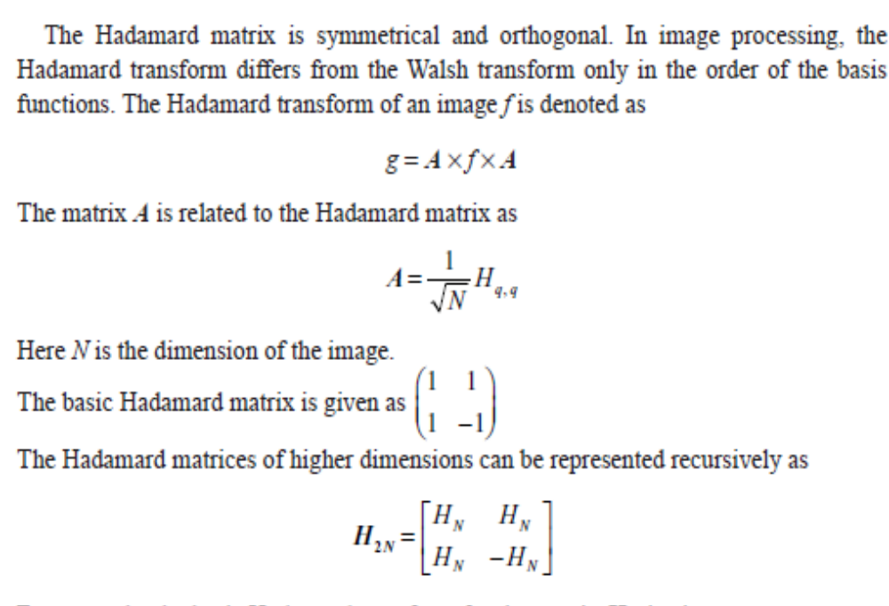

Slide 37
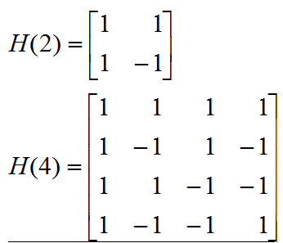

Slide 38
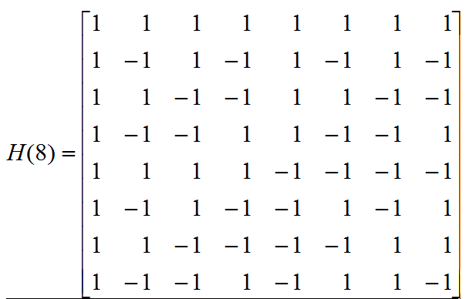

Slide 39
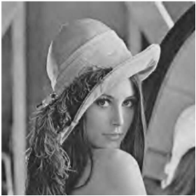
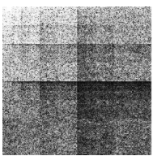

Slide 40
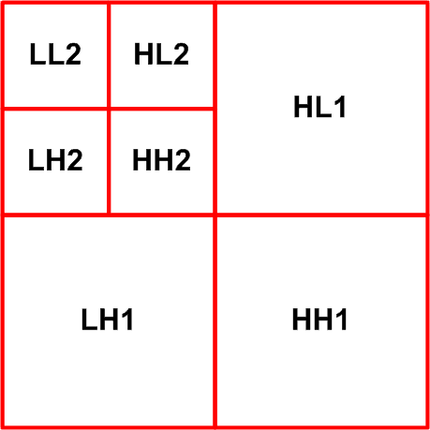
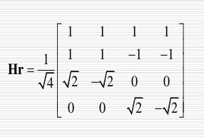
Haar Transform

Slide 41
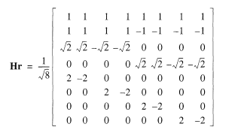

Slide 42
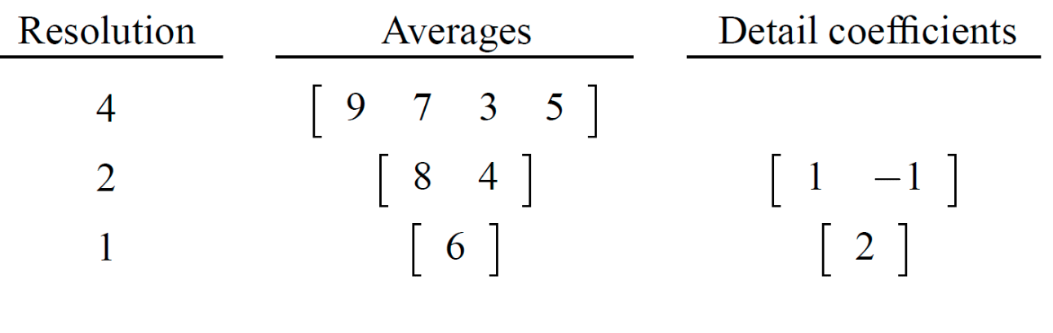

Slide 43
[8 16 10 12 18 8 6 4]

Slide 44
[8 16 10 12 18 8 6 4]
[12 11 13 5] [-4 -1 5 1]
[11.5 9][0.5 4]
[10.25] [1.25]

Slide 45
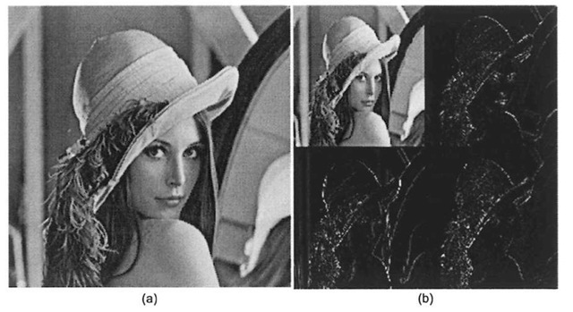
HAAR Transform

Slide 46
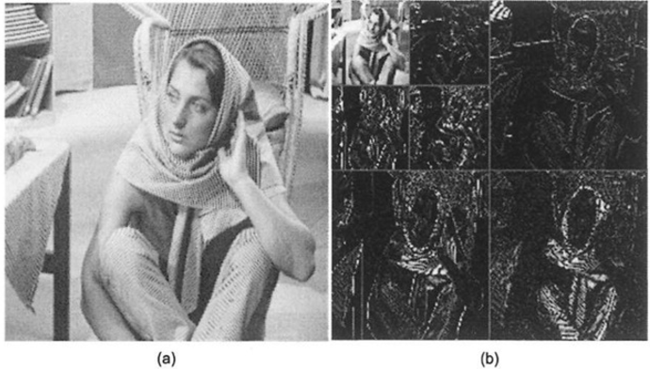

Slide 47
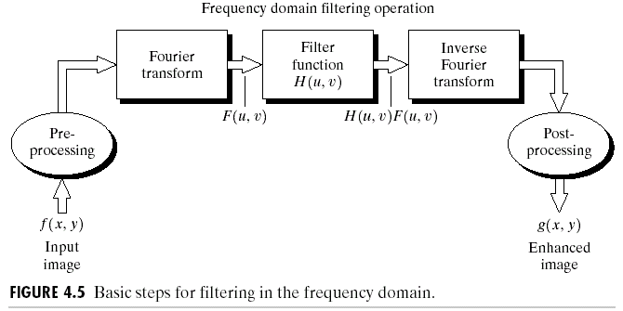

The DFT and Image Processing
To filter an image in the frequency domain:
  Compute F(u,v) the DFT of the image
  Multiply F(u,v) by a filter function H(u,v)
  Compute the inverse DFT of the result
Images taken from Gonzalez & Woods, Digital Image Processing (2002)

Slide 48
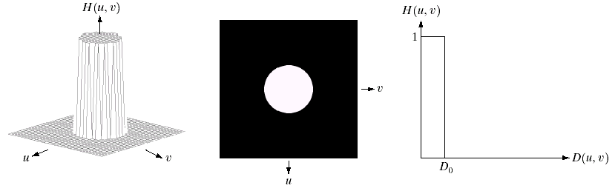
Ideal Low Pass Filter
Simply cut off all high frequency components that are a specified distance D₀ from the origin of the transform
changing the distance changes the behaviour of the filter
Images taken from Gonzalez & Woods, Digital Image Processing (2002)

Slide 49
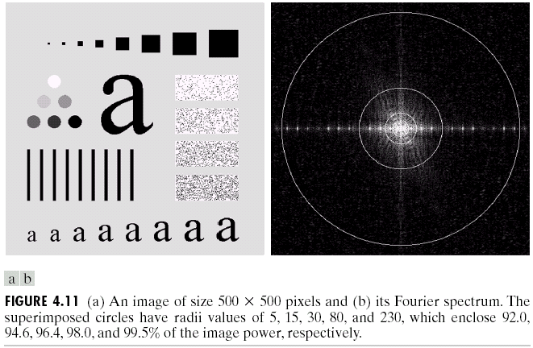
Ideal Low Pass Filter (cont…)
Images taken from Gonzalez & Woods, Digital Image Processing (2002)
Above we show an image, it’s Fourier spectrum and a series of ideal low pass filters of radius 5, 15, 30, 80 and 230 superimposed on top of it

Slide 50
Ideal Low Pass Filter (cont…)
Images taken from Gonzalez & Woods, Digital Image Processing (2002)

Slide 51
Ideal Low Pass Filter (cont…)
Images taken from Gonzalez & Woods, Digital Image Processing (2002)

Slide 52
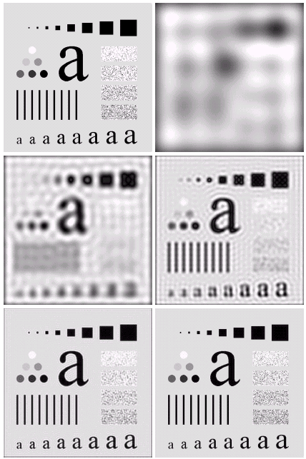
Ideal Low Pass Filter (cont…)
Result of filtering with ideal low pass filter of radius 5
Original
image
Result of filtering with ideal low pass filter of radius 15
Result of filtering with ideal low pass filter of radius 30
Images taken from Gonzalez & Woods, Digital Image Processing (2002)
Result of filtering with ideal low pass filter of radius 80
Result of filtering with ideal low pass filter of radius 230

Slide 53
Ideal Low Pass Filter (cont…)
Result of filtering with ideal low pass filter of radius 5
Images taken from Gonzalez & Woods, Digital Image Processing (2002)

Slide 54
Ideal Low Pass Filter (cont…)
Result of filtering with ideal low pass filter of radius 15
Images taken from Gonzalez & Woods, Digital Image Processing (2002)

